Slide 1
ACT® District Testing at [insert school name]
Expanding College and Career Opportunities at Our School
Notes:
“Thank you for the opportunity to present today. We’ll highlight why bringing ACT District Testing to our school is an important step for student success. This program enables us to offer the official ACT test, right here in our classrooms, during regular school hours — a benefit that greatly expands access and opportunity for all our students.”

Slide 2
Agenda highlights
ACT District Testing Overview and Purpose
Valuable Data for Our Education Programs
Access and Impact
Implementation: What We Can Expect
  How ACT Helps
Cost and Funding
Communication Tools
Test Practice and Preparation Resources
Next Steps
Notes:
Speaker Notes:
“Thank you for joining me for a presentation that could offer our school and our students significant college and career readiness insights that will improve our students’ futures and our educational practices! Today, we will cover the overview and purpose of ACT District Testing, key benefits for students, success stories, data-driven instruction, impact and accommodations, implementation resources, costs, and preparation tools. This comprehensive look will provide insights into the program’s impact and value.”

Slide 3
Why ACT District Testing?

Slide 4

Key benefits: Bringing the ACT test to students during school hours
Students earn college-reportable scores in a familiar school setting.
No Saturday travel, less anxiety, greater participation.
Aligns with our curriculum and instructional planning.
Helps our school meet accountability measures.
Notes:
Speaker Notes:
“By offering the ACT test at school, we dramatically increase test participation, especially among students who may face obstacles getting to a test center on weekends. This means more of our students get a college-reportable score in a comfortable, familiar environment. Because it’s aligned with what’s taught in our classes, it provides our teachers and students with meaningful, actionable data for planning next steps.
“We can also use ACT reporting to meet key accountability measures by providing data that demonstrates student growth and readiness for life beyond high school. We can more easily gather insights to track progress, close achievement gaps, and fulfill state and federal reporting requirements — all while supporting students’ futures.”
”

Slide 5
Key benefits: Helping students succeed
ACT testing is shown to increase access to scholarships and college placement.
    ACT’s Partnership with Going Merry by Earnest = Easier access to scholarships for our students.
Notes:
Speaker Notes:
“Scores from ACT District Testing count for college admissions and scholarships. Just this year, ACT partnered with Going Merry, which combines ACT test scores with financial aid and scholarship access. Students earned more than $8 million in scholarships using Going Merry last year, and offering ACT District Testing would help our students access those funds.”
Bringing the ACT® test to students — in the classroom and during the regular school day.

Slide 6

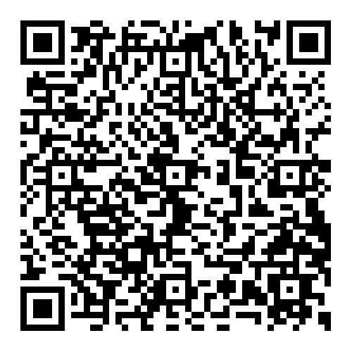
Key benefits: The enhanced ACT test
Reduced number of questions.
Shortened test time.
More time to answer each question.
Reduced answer choices in the math section (from 5 to 4).
Science test is optional.
Notes:
Speaker Notes:
“ACT District Testing now features the enhanced ACT test, with student-focused changes that were implemented based on student and educators’ feedback.
The QR code will give you more information about the enhanced ACT test and what it means for schools.”
The test is now more streamlined, flexible, and accessible – with a reduced number of questions, shortened test time, more time to answer each question, reduced number of answer choices in the math section, and the science section is now optional. Also, the updated format offers schools greater flexibility by allowing a break between core assessments and science and/or writing tests.”

Slide 7

Testimonial
“ACT District Testing has been a wonderful experience for our students and our school this year. We were able to provide a safe and comfortable environment on our campus during the school week to over 130 of our students. Being able to offer it during the school week was amazing!”
Carrie Schmidt, Hayden Catholic High School, Topeka, Kansas
Notes:
Speaker Notes:
“Here is a quote from a longtime ACT District Testing user at a Kansas school.”

Slide 8
Valuable Data to Improve Our Education Programs

Slide 9

Valuable data to improve our education programs
Enables data-driven instruction and targeted interventions.
Monitor growth at student, school, and district levels.
Compare results to state/national benchmarks for context.
Evidence: In-school testing increases participation and success.
Notes:
Speaker Notes:
“ACT District Testing brings us critical college and career readiness data that we can use to measure growth at the student, classroom, school, and district levels. With this data, we can better target our student interventions, monitor performance, and more effectively guide our school improvement efforts. Schools nationwide have seen substantial gains in both participation and college readiness benchmarks through ACT District Testing.”
No Saturday travel, less anxiety, greater participation.
Aligns with our school curriculum and instructional planning.”

Slide 10

Return on investment
Significant returns on investment for our district:
  Expands scholarship eligibility.
  Reduces remediation cost.
  Broader impact on college readiness outcomes
Notes:
Speaker Notes:
”There are many benefits for our students and our school, including giving students greater access to scholarships, less cost for remediation, and better preparedness for the future.”

Slide 11
Access and Impact

Slide 12

Access and impact
Gives rural, low-income, and first-generation students equitable opportunity.
Eliminates barriers: transportation, cost, unfamiliar test centers.
Supports for English learners and students with disabilities through ACT accommodations.
Notes:
Speaker Notes:
“One of the most powerful aspects of ACT District Testing is its impact on fairness for all students. By removing the obstacles of travel, weekend commitments, or cost, we make the ACT accessible to every student — especially those from rural backgrounds or families with limited resources. We also accommodate English learners and students with disabilities, ensuring that everyone can demonstrate their true academic ability.”

Slide 13
Implementation: What We Can Expect

Slide 14

Implementation
Flexible test windows (fall/spring) and digital/paper options.
Flexibility with optional science and writing tests.
Step-by-step checklists provided for coordinators.
Training: Manuals, webinars, and tech support available.
Notes:
Speaker Notes:
“We’ll have significant flexibility in how we roll out ACT District Testing. We can choose from fall or spring test windows and select either paper or digital formats depending on our tech resources. We also have the option of offering students the science and writing sections. The process is supported with checklists, manuals, and direct ACT support to make administration smooth for both our staff and students.”

Slide 15
How ACT Helps with Implementation

Slide 16

Help from ACT with Implementing ACT District Testing
ACT provides robust customer and tech support pre- and post-testing
Implementation support
Customer care support
Dedicated ACT contact for our region
Communication toolkits for students and families
Reporting data
Recognition kits
Notes:
Speaker Notes:
“ACT will be with us 100% as we implement ACT District Testing in our schools – before, during, and after the testing process. It offers 24/7 customer care support, a dedicated account executive for our region, and ways to communicate with our students and families about why the testing is important and what to expect. We will also get reporting data we can use to measure student readiness at the micro and macro levels, as well as recognition toolkits we can use to recognize students’ achievements on ACT testing.”

Slide 17

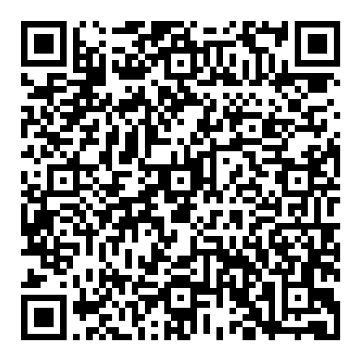
Professional Development for Our Educators
ACT® Instructional Mastery – Formalized training for educators, who get a holistic understanding of the ACT test.
  Teaching strategies.
  In-house ACT test prep.
  Improving college and career readiness instruction at our school.
ACT Professional Learning catalog
Notes:
Speaker Notes:
“For additional support, ACT also offers ACT Instructional Mastery training for our educators to help students prepare for the test, with strategies that can be incorporated into our curriculum to improve students’ college and career readiness.
ACT Instructional Mastery is part of a suite of ACT Professional Learning options. The link at the QR code has a list of professional development options for our educators.”
You can scan the QR code to get more information about ACT Professional Services for our educators.

Slide 18
Cost and Funding FAQs

Slide 19

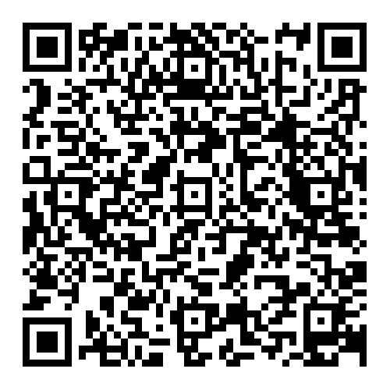
Flexible test windows, formats, and coordinator support
Pricing based on the percentage of students eligible for Free/Reduced Lunch (FRLP).
ACT District Testing customers get discounts on PreACT® 8/9 and PreACT®.
Detailed pricing and scheduling information available at the link.
Notes:
Speaker Notes:
“ACT District Testing is designed to be affordable, with per-student pricing that’s tiered based on the percentage of students eligible for free or reduced lunch. We also have access to additional discounts on PreACT assessments when bundling ACT District Testing. This makes the program accessible to districts of all sizes and means budget should not be a barrier to participation.”
Scan the QR code for more information about pricing, deadlines, scheduling, and more.

Slide 20
Communication Tools

Slide 21

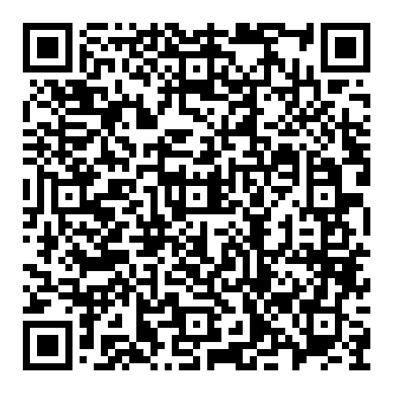
How do we communicate about ACT District Testing with students and families?
Editable parent and staff letters, newsletter blurbs, and posters ready to use.
Social media and announcement graphics included in toolkit.
“Why ACT at School?” infographics available.
Notes:
Speaker Notes:
“To ensure smooth communication, ACT offers a robust toolkit—ready-made emails, letters, social posts, flyers, and infographics—so we can share clear, consistent messages with families, staff, and the broader community. This helps us get buy-in from all stakeholders and ensures our students and families know exactly how to prepare.”
Here’s another QR code with a link to the communication toolkit.

Slide 22
Test Practice and Preparation Resources

Slide 23

Free practice tests, prep guides, and educator resources
Online Practice Tests
  Full-length online practice tests and free sample questions help students prepare effectively.
Official Prep Guides
  Official ACT Prep Guide and online resources powered by MasteryPrep offer comprehensive study materials.
Educator and Student Access
  Accessible practice resources and guides are available for every testing platform to support educators and students.
Notes:
Speaker Notes:
“Preparation is key to reducing test anxiety and boosting scores. ACT provides a wealth of free test prep tools—online practice tests, sample questions, prep guides, and even a robust online platform with diagnostic and progress tools. By integrating these resources, we set up our students for success on test day and beyond.”

Slide 24

Level-up test prep and practice
ACT® Online Prep™, Powered by MasteryPrep
  Next-generation ACT test prep platform delivered in classrooms.
PreACT® assessments
    PreACT® 8/9, - 8th and 9th grades
    PreACT® 9 Secure™, - 9th grade
    PreACT® – 10th grade
    PreACT® Secure ™ – 10th grade
    Bundled pricing
Notes:
Speaker Notes:
“ACT also offers test prep that gives our students early experience with the format and content of the ACT test – the ultimate test prep. First is ACT Online Prep, Powered by MasteryPrep, which offers engaging, in-classroom practice on test items that boosts performance on the test and gives students confidence.
Second are PreACT assessments – including PreACT 8/9 for eighth and ninth graders, PreACT for 10th graders, and PreACT Secure and PreACT Secure 9, for high-stakes accountability purposes. All PreACT assessments gives students early experience with ACT test questions and format, a predicted ACT test score, and college and career prep information. Our district gets a discount on PreACT assessments when we become ACT District Testing customers.”

Slide 25
Next steps and contacts
Gather questions and feedback.
Review ACT links, toolkits, and plan district Q&A session.
Contact ACT for customized support and implementation guidance:
  ACT District Testing Hub
  ACT Support Contacts
Notes:
Speaker Notes:
“What I’d like to do now is open up this presentation for discussion and questions. We also have links and toolkits to share.”

Slide 26
Thank you!

Slide 27
Extra slide - Personalize this presentation and make the case for your school
Feel free to add to this presentation with state- or region-specific information to bolster your case for using ACT District Testing at your school or district, including:
  State accountability measures, and how ACT testing can help you meet them.
  School report card.
  ACT education insights specific to your state – click here.

